Slide 1

Open-MCT Based iCub Telemetry Data Visualization Tool
Nuno Guedelha, Silvio Traversaro, Stefano Dafarra
AMI Research Increment 05-10-2021

Slide 2
Motivation
Running an experiment…
Hard time constraints
Setup complexity
Stress
Requires…
Repeatability (automatized repetitive actions)
Centralized control and visualization
Flexibility (easy selection of telemetry data)
Robustness (survive robot interface reboot)

Slide 3

Motivation
Start YARP server
Run Yarpmanager
Load app config
Example $⟹$ walking demo
Reading YARP ports from terminal
Overhead effort
Running apps: yarpview, iCubGUI, WalkingModule
Run individual plotters
Monitoring
Control Inputs
Connecting ports
Battery status
Walking Coord.
Type RPC commands
External forces
Virtualizer
Reading YARP ports from terminal
cameras
VR + gloves
RobotViz.
Sensorised suit
RPC client on terminal
Organize workspace
Notes:
Yarpmanager tool
The command-line utility "yarpmanager-console" and its graphical companions "yarpmanager" are tools for running and managing multiple programs on a set of machines.
Create apps from third-party apps, yarp modules and/or devices (yarpdev <device>)
Define app resources
Connect/disconnect ports

Slide 4
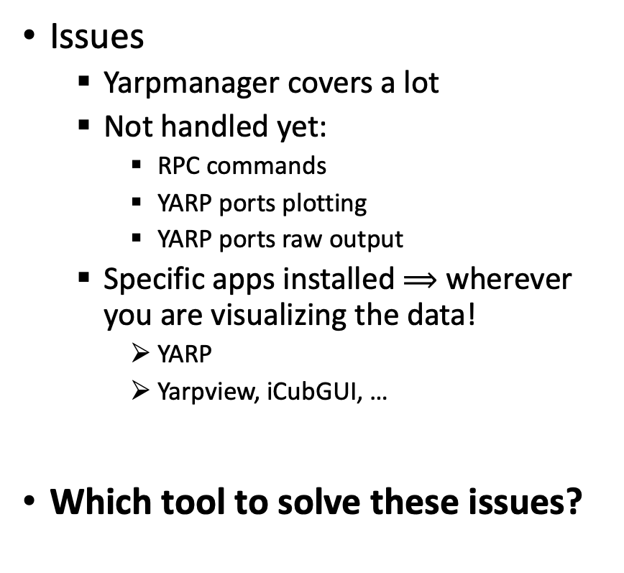
Motivation
Issues
Yarpmanager covers a lot
Not handled yet:
RPC commands
YARP ports plotting
YARP ports raw output
Specific apps installed $⟹$ wherever you are visualizing the data!
YARP
Yarpview, iCubGUI, …
Which tool to solve these issues?
Start YARP server
Run Yarpmanager
Load app config
Reading YARP ports from terminal
Overhead effort
Run individual plotters
Type RPC commands
Organize workspace
CTRL Console
Robot
Visualizer
4

Slide 5
Outline
why Open-MCT?
Open-MCT visualizer Overview: features and current limitations
Control Console Overview: a Remote RPC web interface
Architecture overview and protocols
Connecting YARP data output ports to the visualizer web client
Connecting the YARP RPC ports to the control console web client
Installation, parametrization and launching
Deployment and next steps

Slide 6
why Open-MCT?
 | imgui | PlotJuggler | Foxglove | OpenMCT
Applications | 3D games / apps | Timeseries plots | Diag/viz robotics | Space missions
Features/Ergonomy | Smaller building blocks | Intuitive? Light interface | Robot 3D viz. visualization State transitions | Adv. Ploting, layout Plot <-> raw data State transitions
Integration / Portability | Any module integ. C++ libraries | Desktop app Websocket, CSV ROS | Desktop app ROS-Linux | Web app (websocket) Yarp.js
Modularity (UI, plugins) | Full freedom | Data source Plugins | ? | JS/JSON plugins Custom widgets num,image data
Base language / build tools | C++ | C++ | Node.js, Yarn, npm | JS, HML, Node.js, npm
Developper learning curve | Very slow | ? | ? | average
Notes:
Positive
Nice clear online plots, and easy to export to PNG, JPG formats.
Easy to place component widgets on the main board.
Easy switch between plots and table of function values.
Easy full screen mode, native browser window zoom options.
Negative
Exported plots are blurry.
Local/UTC clock interface a bit confusing.
in-window-zoom fixes timespan (there seems to be a static zoom only, freezing the data).
No apparent axis options on the plots.
Javascript -> scripting language for web dev (JS in brwser)
Node.js -> open-source, JS runtime env (JS outside of browser)
Websocket API => multi-channel duplex over TCP connection
TCP -> layer 4
HTTP/Websocket -> layer 7
HTTP [half-duplex] / Websocket [full-duplex] -> facilitates real-time communication over TCP
ws|wss URI (Uniform Resource Identifier) -> ws://some-address.com:10000/a-channel
Supported by Google Chrome, Firefox, Microsoft Edge, Internet Explorer, Safari and Opera

Slide 7
why Open-MCT?
 | imgui | PlotJuggler | Foxglove | OpenMCT
General Impression | Too complex | Many data source interfaces Only timeseries measurements | Promising ROS-Linux deps to tackle | Great portability Web based Evolving features
Notes:
Positive
Nice clear online plots, and easy to export to PNG, JPG formats.
Easy to place component widgets on the main board.
Easy switch between plots and table of function values.
Easy full screen mode, native browser window zoom options.
Negative
Exported plots are blurry.
Local/UTC clock interface a bit confusing.
in-window-zoom fixes timespan (there seems to be a static zoom only, freezing the data).
No apparent axis options on the plots.
Javascript -> scripting language for web dev (JS in brwser)
Node.js -> open-source, JS runtime env (JS outside of browser)
Websocket API => multi-channel duplex over TCP connection
TCP -> layer 4
HTTP/Websocket -> layer 7
HTTP [half-duplex] / Websocket [full-duplex] -> facilitates real-time communication over TCP
ws|wss URI (Uniform Resource Identifier) -> ws://some-address.com:10000/a-channel
Supported by Google Chrome, Firefox, Microsoft Edge, Internet Explorer, Safari and Opera

Slide 8
Open-MCT visualizer Overview
Adapted for planning and visualization
streaming and historical telemetry data
imagery
timelines
Data plots in:
fixed time span
Sliding, fixed width time span
Data display can be toggled to table of values or plot.
5 component types free to create:
Timeline of operations
Folders
Activity Modes (predefined variables updated at fixed intervals or scheduled timestamps).
Clocks
Custom grid stacked/Overlay plots
Notes:
Open MCT can be adapted for planning and operations of any system that produces telemetry. Can display in one place:
streaming and historical data,
imagery,
timelines,
procedures,
other data visualizations.
NASA => use as:
Data visualization tool in support of multiple missions at the Jet Propulsion Laboratory.
Ames Research Center to support the development of lunar rover mission concepts
5 component types:
Timeline of operations: like a roadmap of tasks with a cursor indicating the present time.
Folders: can contain other components.
Activity Modes: Displays values of predefined variables updated at fixed intervals or scheduled timestamps (not sure).
Clocks: Displays UTC real time.
Stacked plots: 2-D plots arranged in a custom grid.

Slide 9
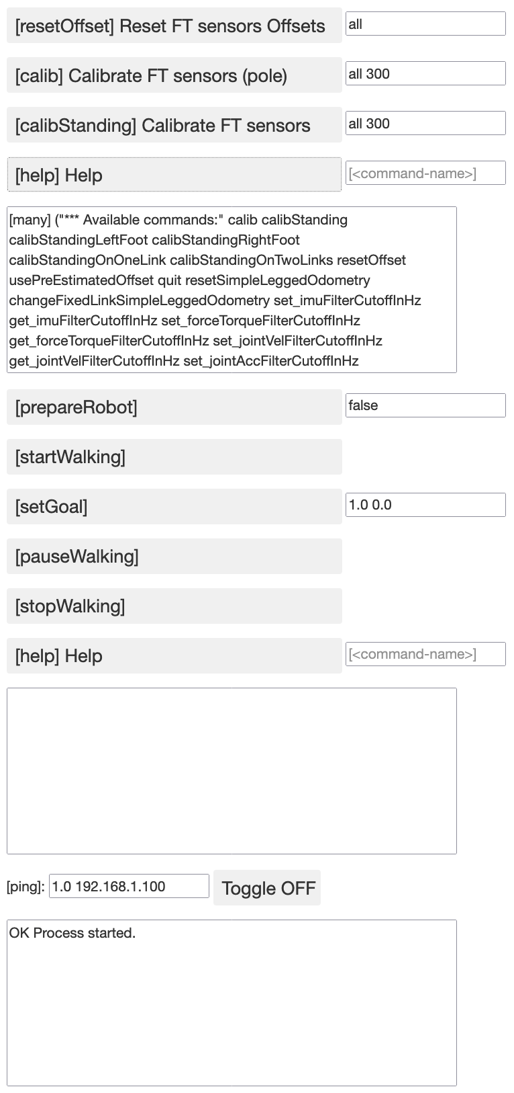
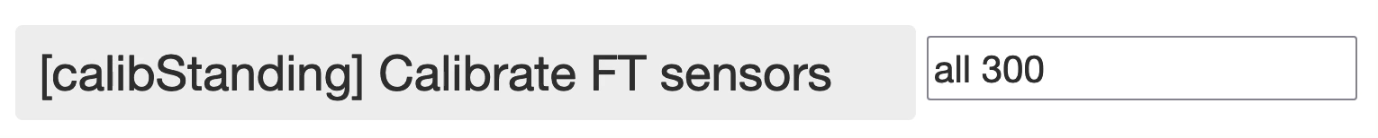
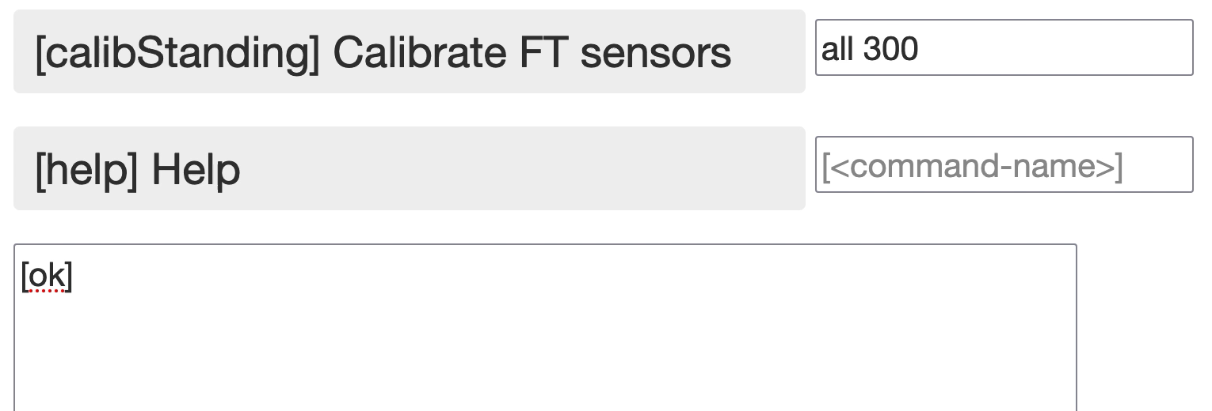
Control Console Overview: a Remote RPC web interface
Feature Highlights
Same RPC interface as on terminal
Pre-filled defaults or placeholders
Reply text box for each interface
Re-used yarp.js-socket RPC API for Ping system command.
FT calibration interface
Walking Coordinator interface
VOCAB
Returned Data
Ping interface

Slide 10
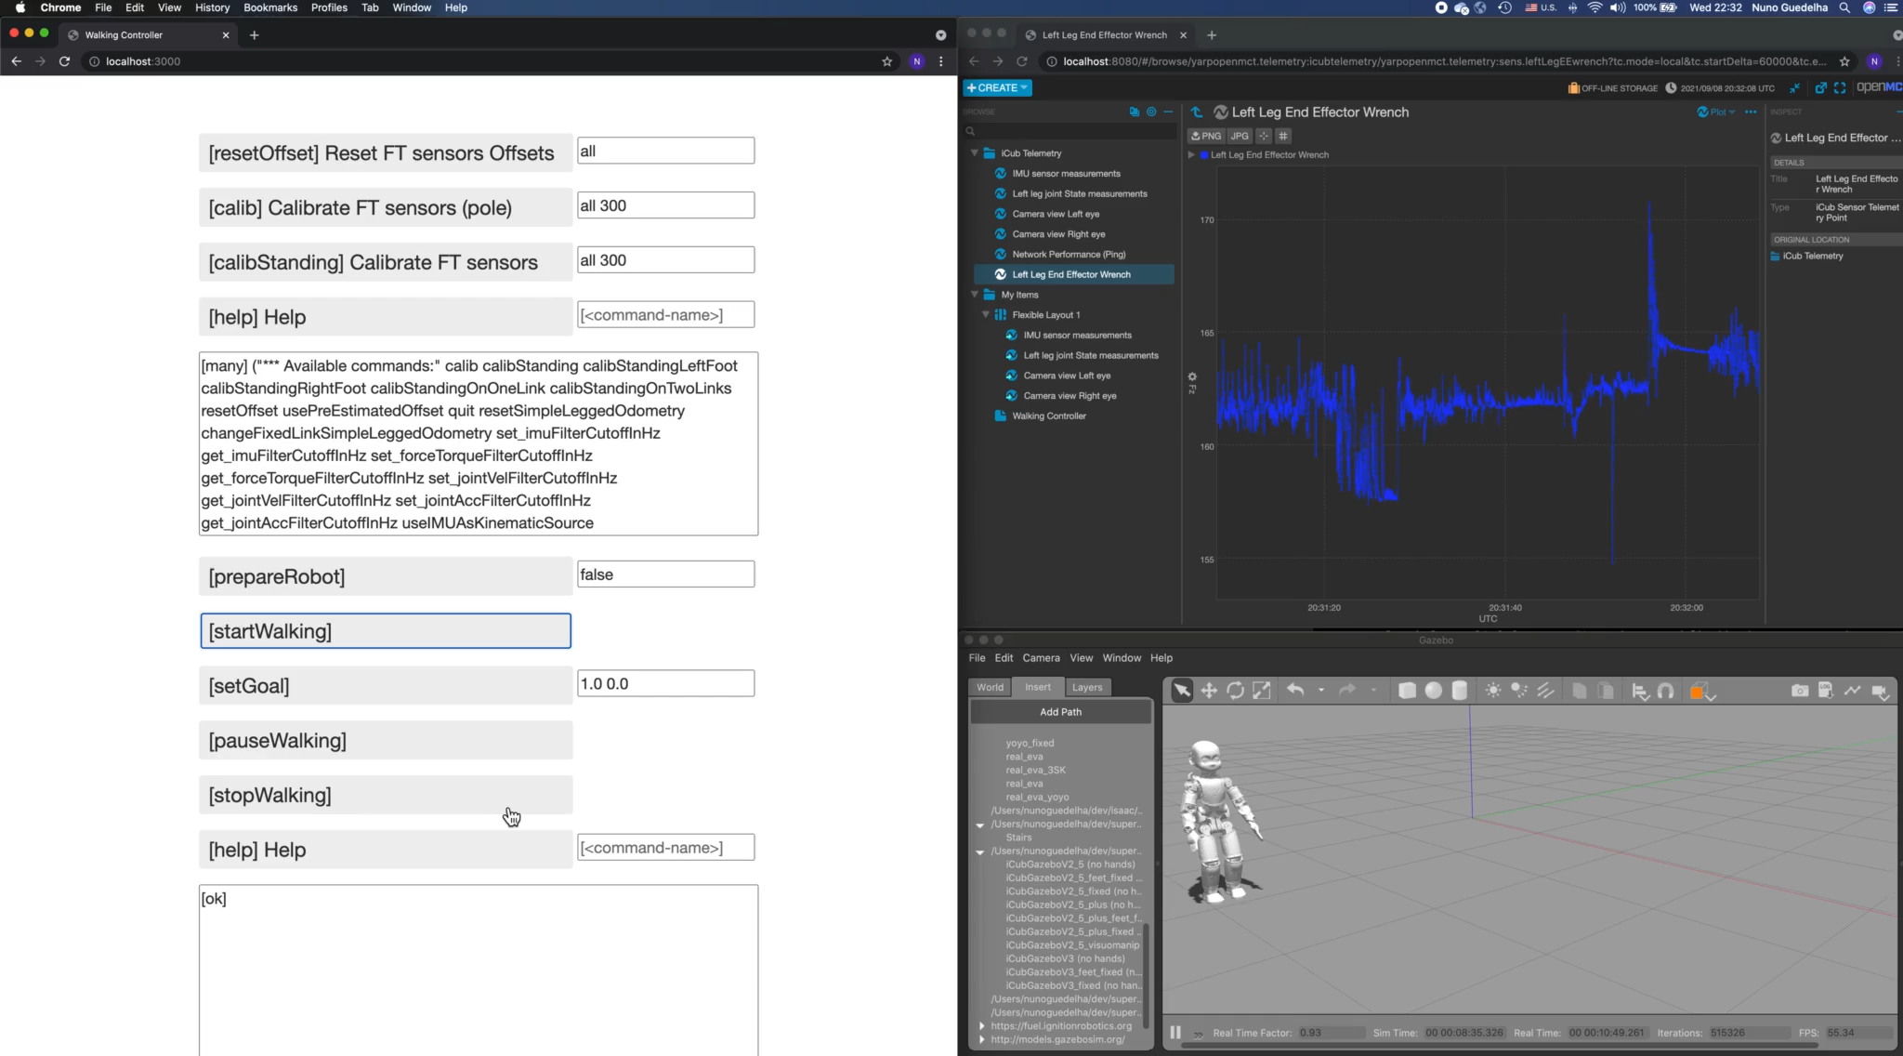
Combined Interfaces

Slide 11
Architecture Overview and Protocols

Slide 12
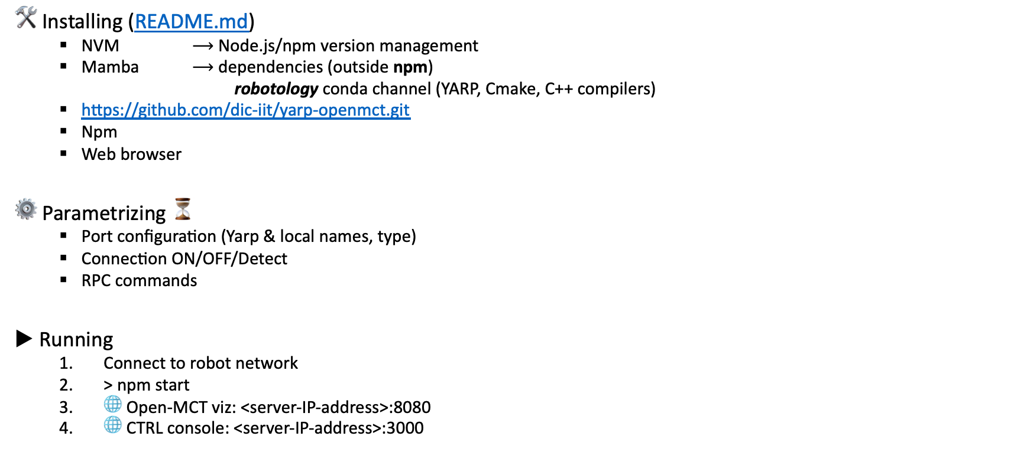
Installing, parametrizing and launching
🛠 Installing (README.md)
NVM $⟶$ Node.js/npm version management
Mamba $⟶$ dependencies (outside npm)
robotology conda channel (YARP, Cmake, C++ compilers)
https://github.com/dic-iit/yarp-openmct.git
Npm
Web browser
⚙️ Parametrizing ⏳
Port configuration (Yarp & local names, type)
Connection ON/OFF/Detect
RPC commands
▶︎ Running
Connect to robot network
> npm start
🌐 Open-MCT viz: <server-IP-address>:8080
🌐 CTRL console: <server-IP-address>:3000

Slide 13
Deployment and Next Steps
Tested on iCubGenova04
Running modules and app from terminal
Controle console
RPC commands
Network Ping
Open-MCT based visualizer
Individual iCub telemetry entry plots
CTRL console
Issues analysis in progress…
Next steps
Improve runtime stability
Stacked & overlay plots
Added 3D robot viz
Imporve the control GUI

Slide 14
Connecting YARP data output ports to the visualizer web client

Slide 15
Connecting the YARP RPC ports to the control console web client

